Slide 1

Network Troubleshooting and Security
network troubleshooting and security are essential for maintaining a reliable, efficient, and secure network environment.

Slide 2
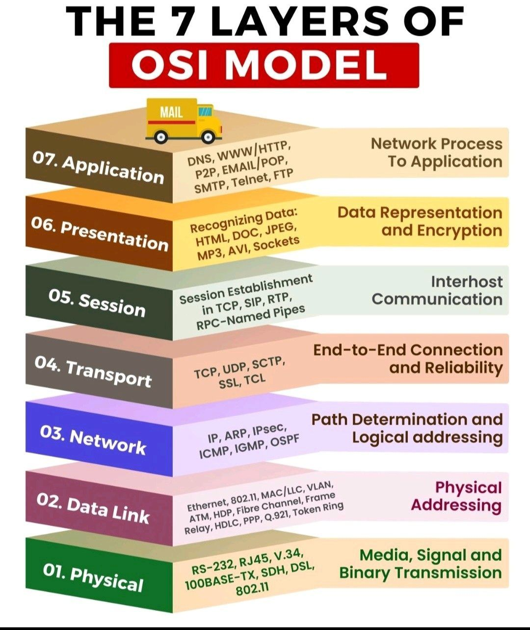
OSI (Open systems Interconnection)Model

Slide 3
Troubleshooting layer 3 (Network Layer)
Troubleshooting Layer 3 problems involves diagnosing issues related to the network layer of the OSI model, where IP addressing and routing occur
Troubleshooting Layer 3 problems involves diagnosing issues related to the network layer of the OSI model, where IP addressing and routing occur:
IP Addressing Problems (Misconfigure IP address or subnets, Duplicate IP address, Incorrect subnet masks)
Routing Problems (Incorrect static router, Missing or misconfigured dynamic routing protocols (e.g., OSPF, EIGRP), Routing table issues)
Connectivity Issues (Devices unable to reach each other across networks, Issues with NAT (Network Address Translation)
Firewall Issues (Misconfigured access control lists (ACLs) blocking traffic, Incorrectly set up firewall rules preventing communication)

Slide 4
Network Security Model
Classical Encryption in Modern Network Security Models:
Confidentiality: Ensuring that data is accessible only to those authorized to access it.
Integrity: Ensuring data has not been altered during transmission.
Authentication: Verifying the identities of the parties involved in the communication.
Non-repudiation: Ensuring that a sender cannot deny having sent the message.
Note: Modern encryption techniques, such as Advanced Encryption Standard (AES), RSA, and Elliptic Curve Cryptography (ECC), incorporate many of the ideas from classical encryption but with far greater mathematical complexity and security against modern attacks.

Slide 5
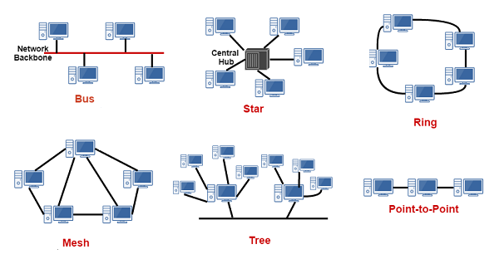
Topology

Slide 6
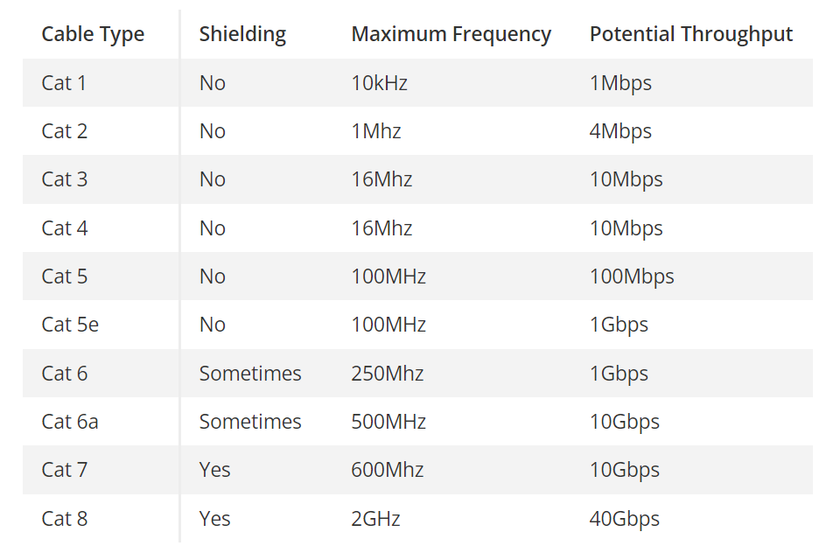
Network Cabling

Slide 7
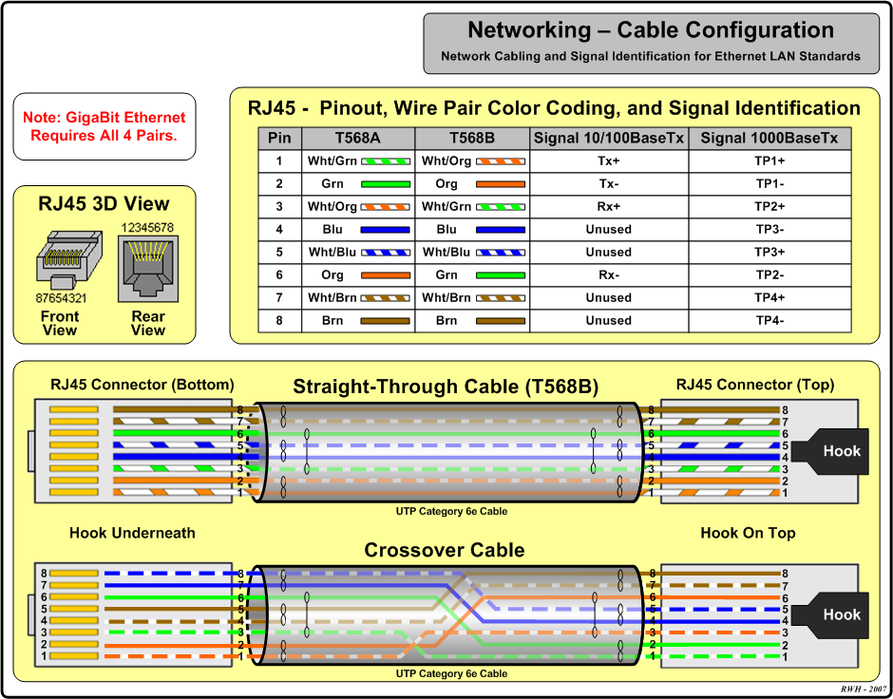
Network Cabling color code (straight & cross Over)

Slide 8
Institute of Electrical and Electronics Engineers (IEEE):>>>>NIS
IEEE has developed various standards under 802 family, which addressing communication and networking protocols, especially for LANs, MANs.
IEEE 802.3 (Ethernet)
IEEE 802.11 (Wi-Fi) --- 802.11a, 802.11b, 802.11g, 802.11n, 802.11ac, 802.11ax (Wi-Fi 6) etc.,
IEEE 802.1 (Bridging & Networking Management)
VLANs (802.1Q)
STP (Spanning tree protocol)--- It prevents networks loops in bridges(switches networks).
Networking Industry Standards (IEEE)

Slide 9
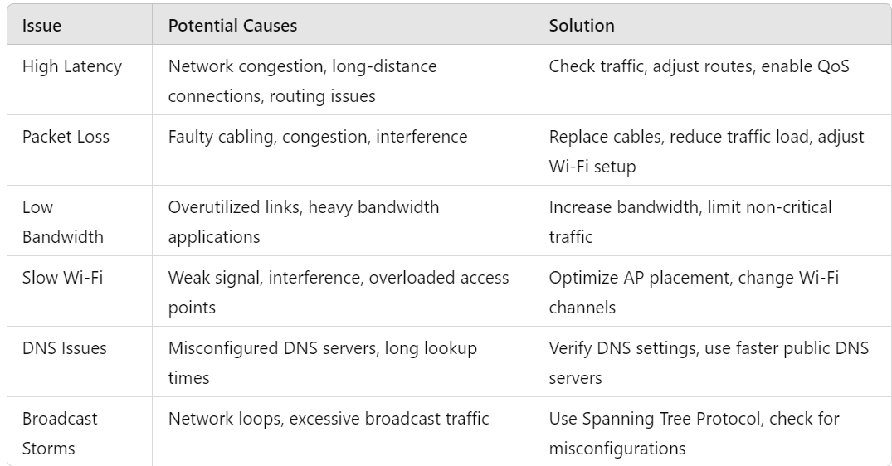
Troubleshooting
network performance issues

Slide 10
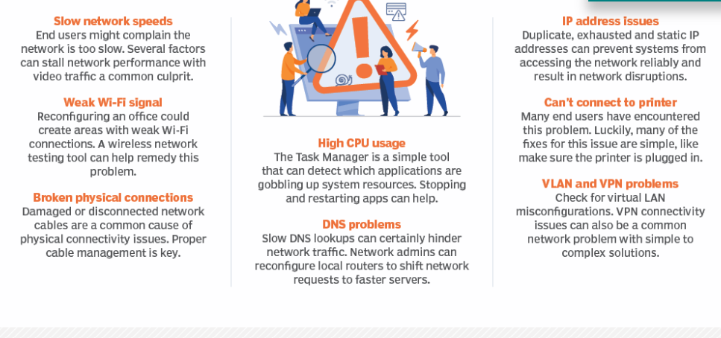
Troubleshooting
network performance issues

Slide 11
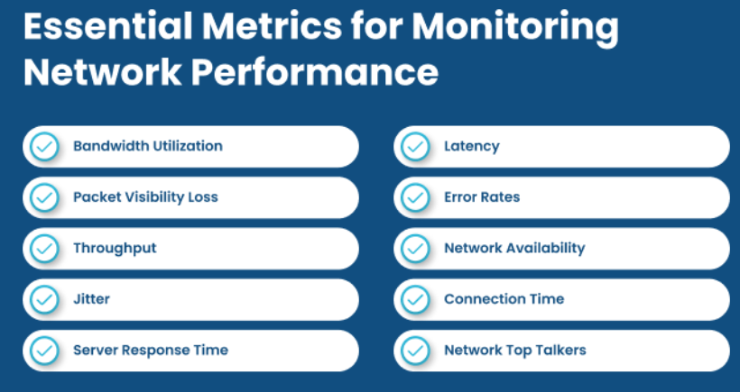
Network device performance metrics are key indicators that help network administrators monitor and troubleshoot network devices such as routers, switches, firewalls, and access points.
Network Device key metrics

Slide 12

Thank you
rajadhurai_sentinel@proton.me

Slide 13
A MAC address (Media Access Control address) is a unique identifier assigned to network interfaces for communications on the physical network segment.
It is used to ensure that data is properly directed to the correct device in a local network.
A MAC address is a 48-bit number, typically represented as 12 hexadecimal characters (0-9, A-F), often grouped into pairs for readability.
where each pair of characters represents 8 bits (1 byte).
Example: 00:1A:2B:3C:4D:5E
The first 24bit represent OUI (Organizationally Unique Identifier), Manufacturer of Network Device.
The remaining 24bit are unique to the device, are assigned by the manufacturer.
UNIT II
TCP/IP ROUTING
MAC ADDRESS

Slide 14
Purpose– Identification: A Mac address uniquely identifies a device on a network. (Ex. Wi-Fi, Ethernet)
Data Transmission: In a local area network (LAN), devices communicate using MAC addresses. When data is sent over the network, it is encapsulated in a frame that includes the MAC address of both the sender and the receiver.
Where MAC Addresses Are Used:
Ethernet and Wi-Fi Networks
Switches
ARP (Address Resolution Protocol)
Type of MAC Address: Static and Dynamic MAC Address
Security Implications: Mac Filtering, Spoofing can be happened
UNIT II
TCP/IP ROUTING
MAC ADDRESS

Slide 15
UNIT II
TCP/IP ROUTING
Ip address

